Slide 1
Micro Credit Defaulter Analysis
By:
Sreekari I

Slide 2
Data description
The data is about a client in telecom industry who is collaborating with an Microfinance Institution (MFI) to provide micro-credit on mobile balances to be paid back in 5 days. They are focusing on providing their services and products to low income families and poor customers that can help them in the need of hour.
For the loan amount of 5 (in Indonesian Rupiah), payback amount should be 6 (in Indonesian Rupiah), while, for the loan amount of 10 (in Indonesian Rupiah), the payback amount should be 12 (in Indonesian Rupiah). i.e, the interest rate on the loan is 20%

Slide 3
Objective:
Now a days the prediction of defaulting the borrower in future is a challenging task for credit provider institutions. Therefor the main objective is to develop prediction models for defaulting the borrower in the future by taking advantage of available technological advancement.

Slide 4
Conventions used for this project
The Consumer is believed to be defaulter if he deviates from the path of paying back the loaned amount within the time duration of 5 days.
The Consumer is believed to be a non defaulter if the loaned amount is paid within the time duration of 5 days.
Defaulters are labelled as '0'
Non-defaulters are labelled as '1'

Slide 5

Scenarios…
Is it beneficial to lend someone who has a risk of not repaying the money back??
Is it “HUMANITY” to lend credit someone who is in deep trouble?
How to separate the above population from a pool of beneficial party?

Slide 6
Why to go for Modelling?
Insights of the Data, which is very difficult to get from the dataset without a software.
Assuring with an accuracy for the correctness of the predicting the defaulters

Slide 7
About The Project
Trained with a dataset of 209593 rows and 37 columns
Here the following Algorithms are used for the prediction
Logistic Regression
Naïve Bayes
Decision Tree
Random Forest

Slide 8
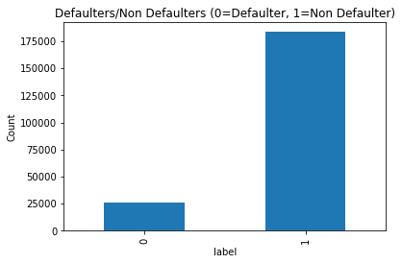
The dataset is imbalanced. Label ‘1’ has more than 1,75,000 records, while, label ‘0’ has approximately 25,000 records.

Slide 9
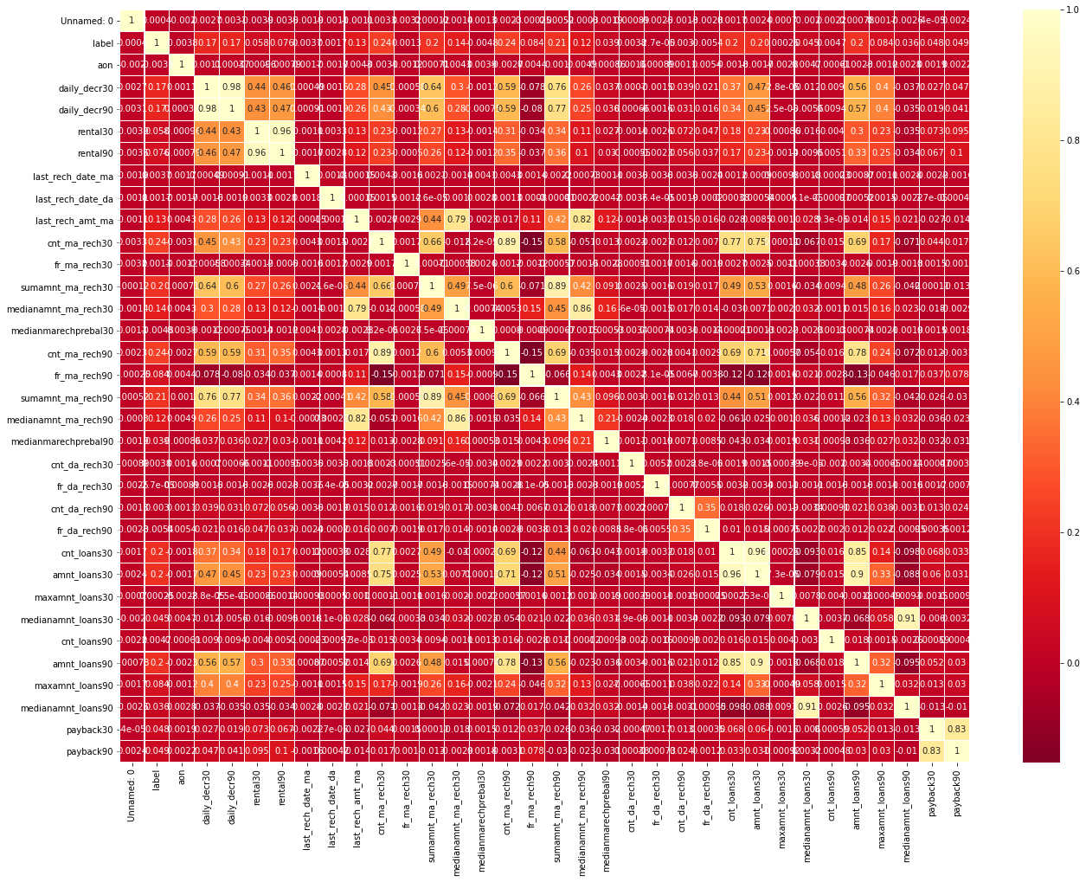
Heatmap

Slide 10
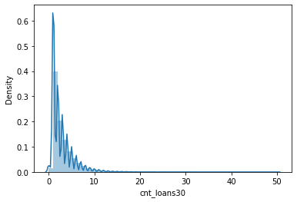

Slide 11
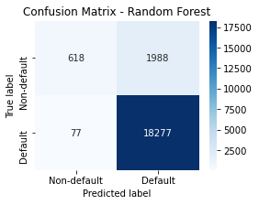

Slide 12
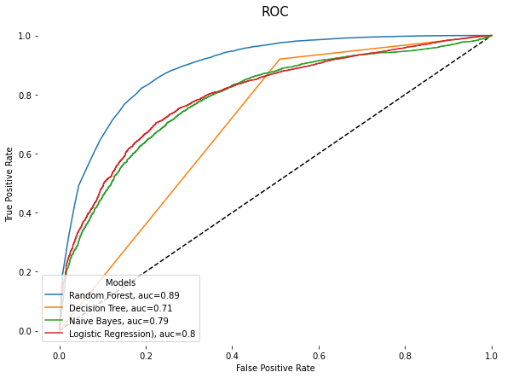
From the ROC curve, we can see that the Random Forest model gives best accuracy for this project.

Slide 13
Conclusion Here, you can see the random forest prediction works very well, which means it can confidently tell you who is the good customer. By contrast, it has a pretty low recall when predicting the loan default behaviours. In laymen’s terms, recall means how many cases are predicted correctly among all the true conditions. They only cover a small part of the total amount of customers with non default behaviours. To improve the recall of the model, we can use the the probabilities predicted by the model and set threshold by ourselves. The threshold is set based on several factors such as business objectives. It is different case by case. In credit behaviour prediction, for example, micro finance institutions want to control the loss to a acceptable level, so they may use a relatively low threshold. This means more customers will be grouped as “defaulters” and their profiles will be checked carefully later by the credit risk management team. In this way, the telecom industry can detect the default behaviours in the earlier stage and conduct the corresponding actions to reduce the possible loss.

Slide 14
THANK YOU !!

